Slide 1

Internship Program: Soulvibe.Tech
“Power BI in Action:
Cleaning, Analyzing, and VisualizingCollege Course Data”
NAME: PONNANA SURENDRA
Batch Name: SVT/DAINT/2025/06/B10

Slide 2

Introduction
Overview of the main objectives
My goal for this task is to demonstrate my ability to use Power BI. I will be focusing on cleaning, analyzing, and visualizing educational course data from the provided CSV file, which contains information about colleges, universities, courses, districts, and talukas.

Slide 3
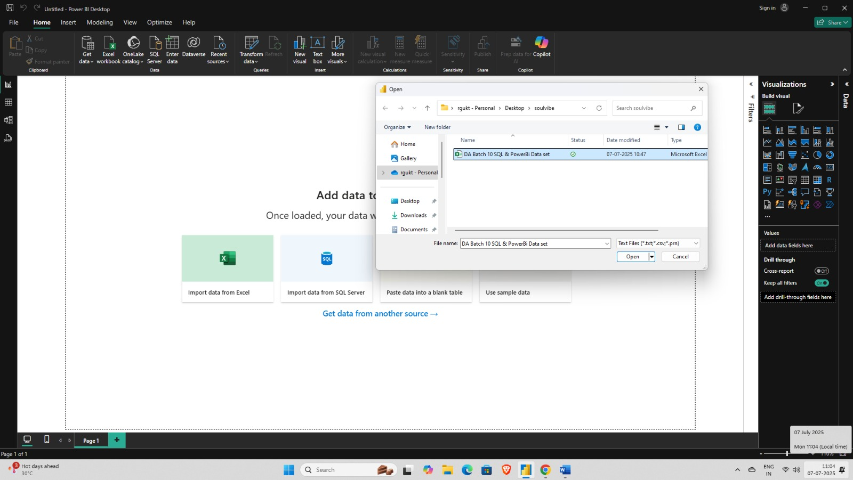
Connect to the Data

Slide 4
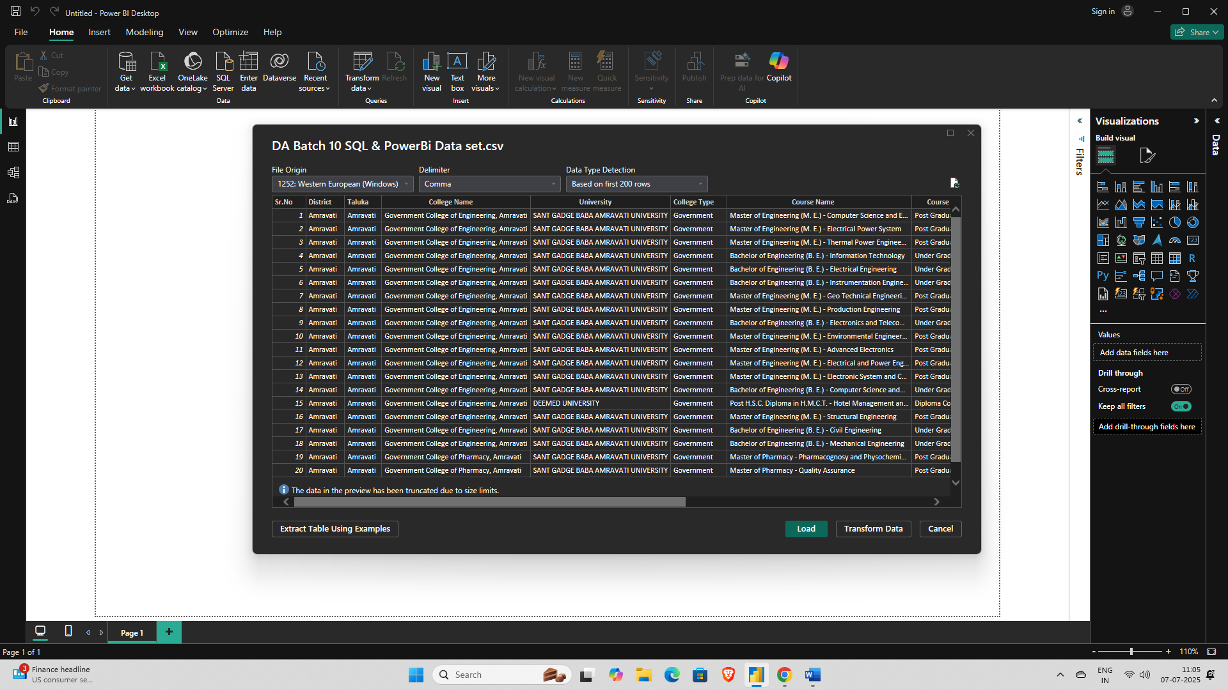
Connect to the Data
1

Slide 5
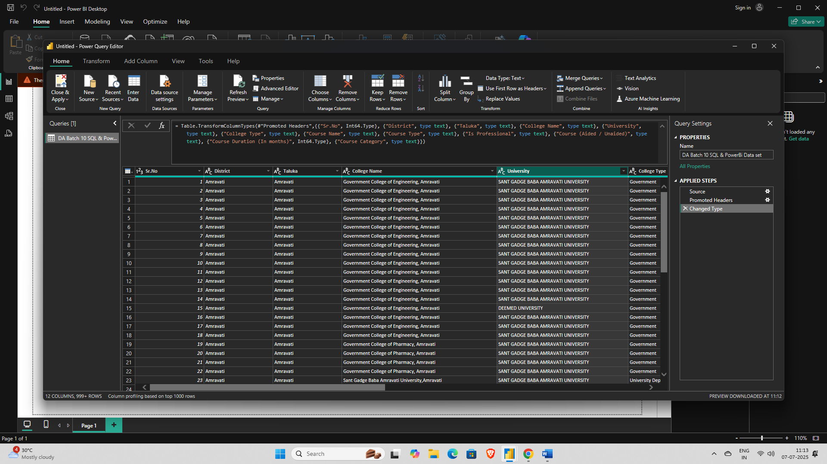
Clean & Prepare the Data
1

Slide 6
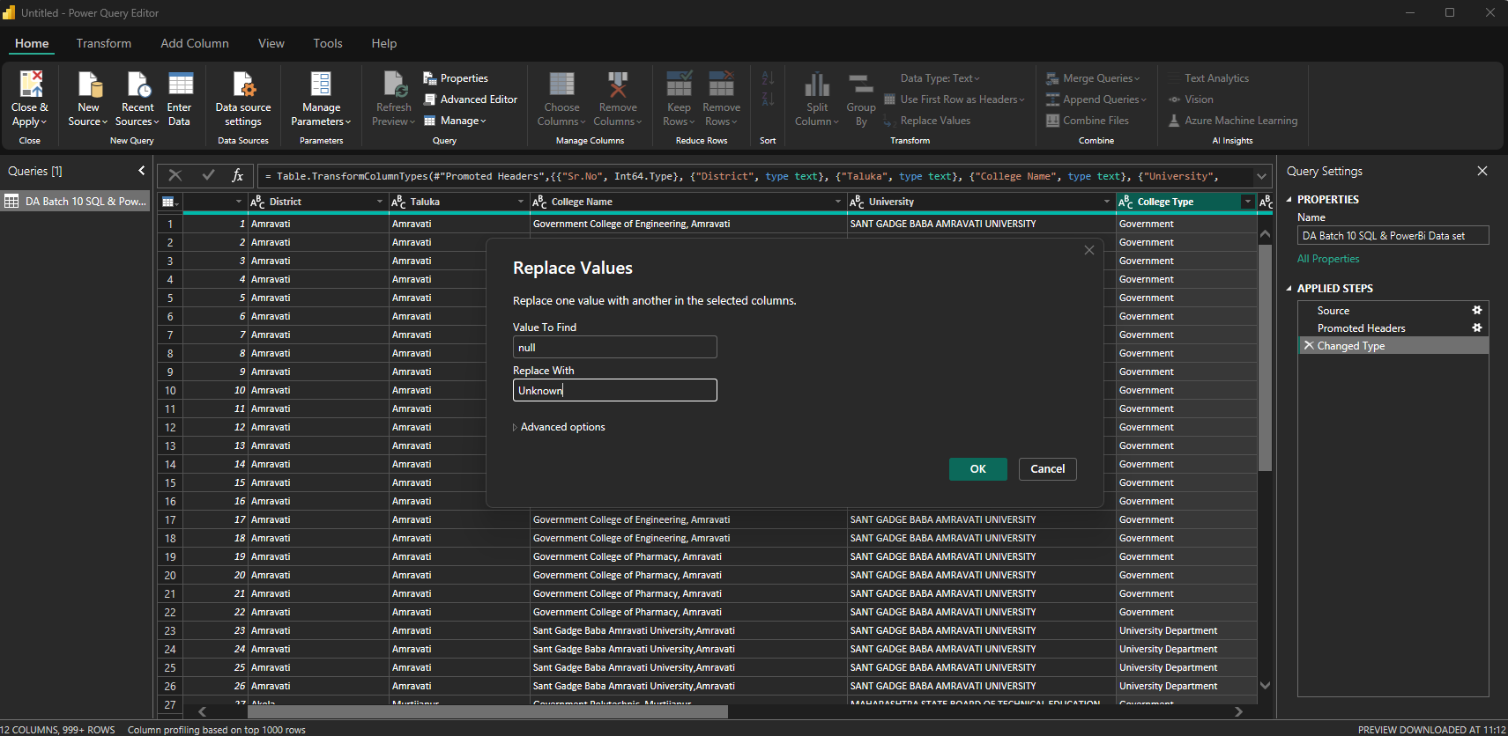
Clean & Prepare the Data
1

Slide 7
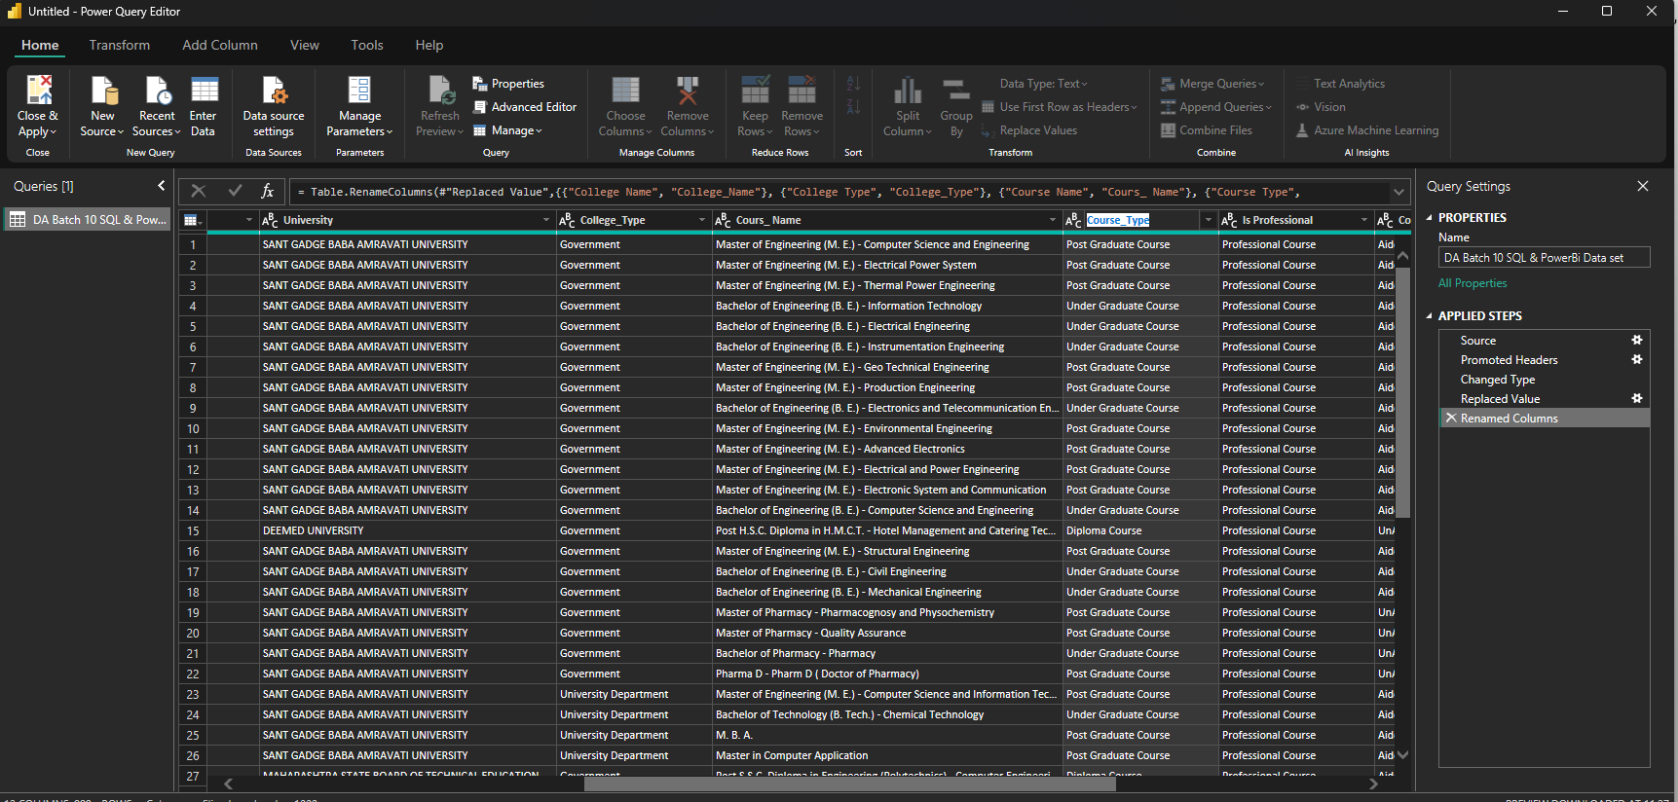
Clean & Prepare the Data
1

Slide 8
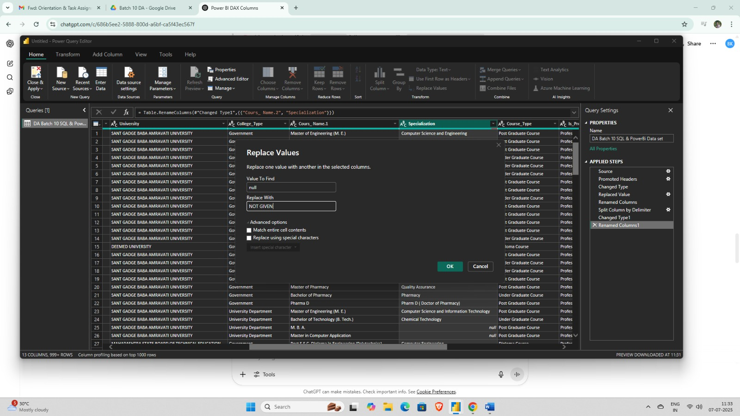
Clean & Prepare the Data

Slide 9
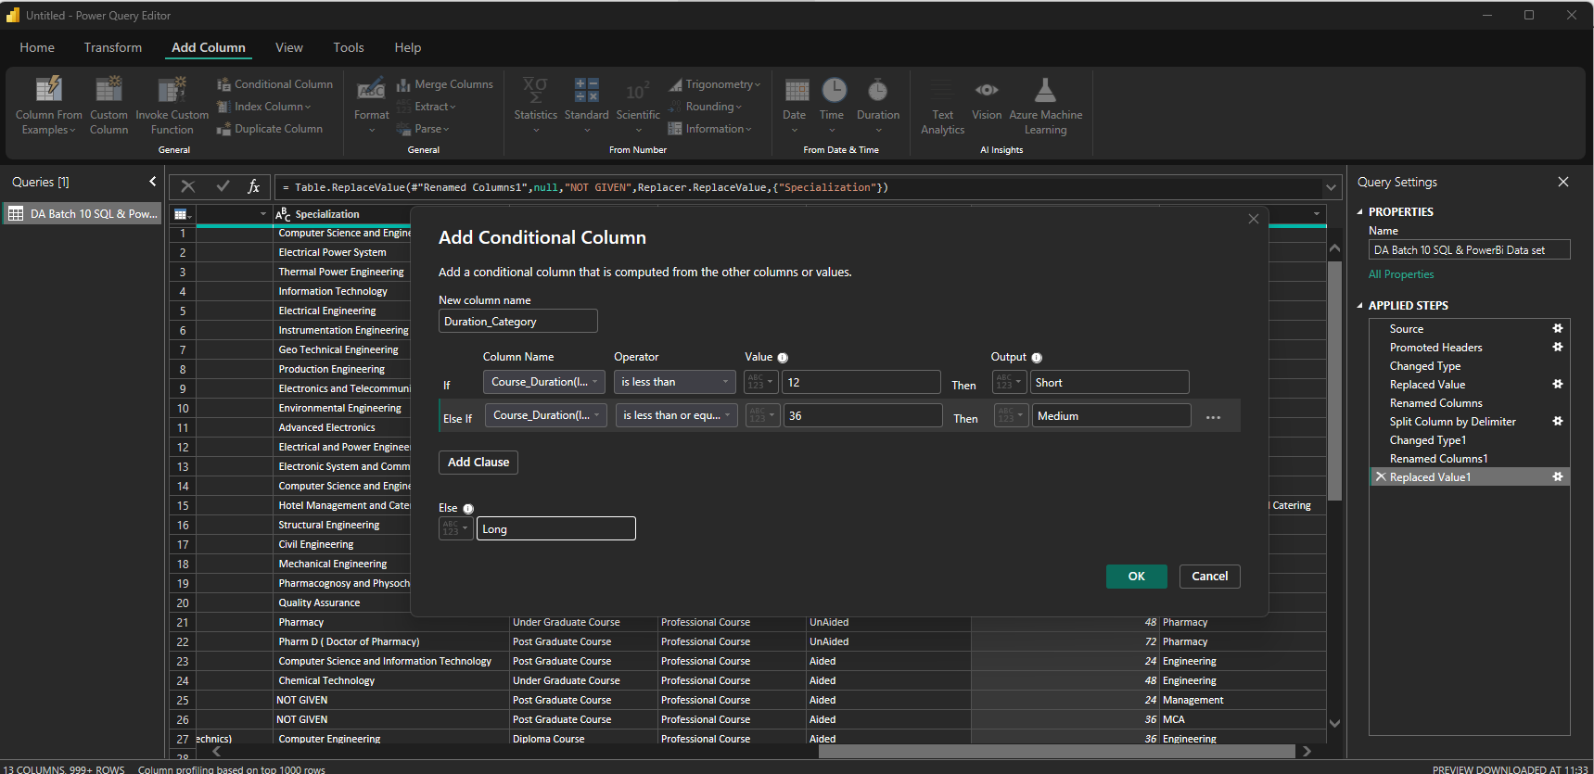
Clean & Prepare the Data
1

Slide 10
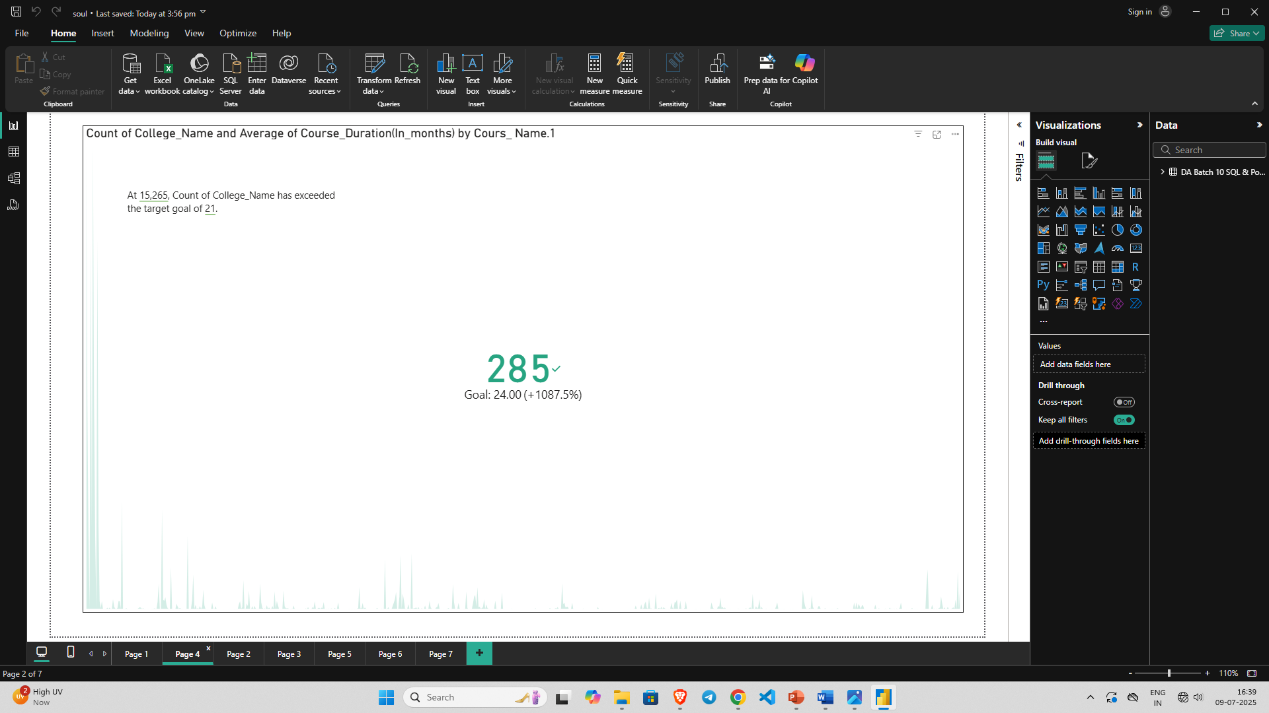
Create Visualizations-KPI Cards
1

Slide 11
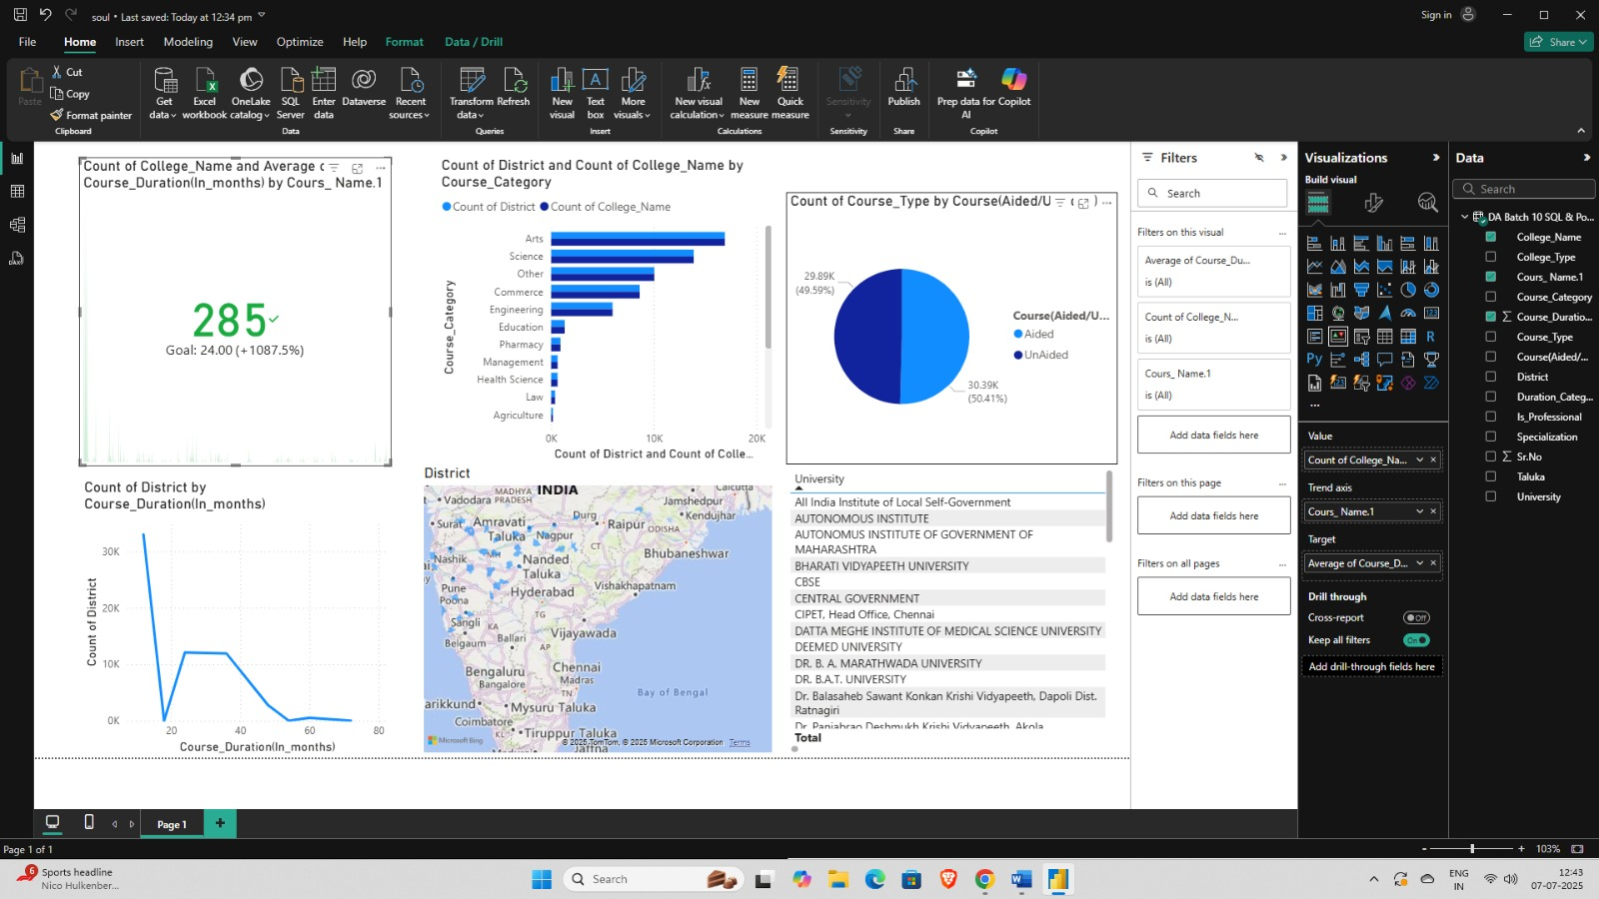
Create Visualizations-Bar Charts
1

Slide 12
Create Visualizations - Pie Charts
1

Slide 13
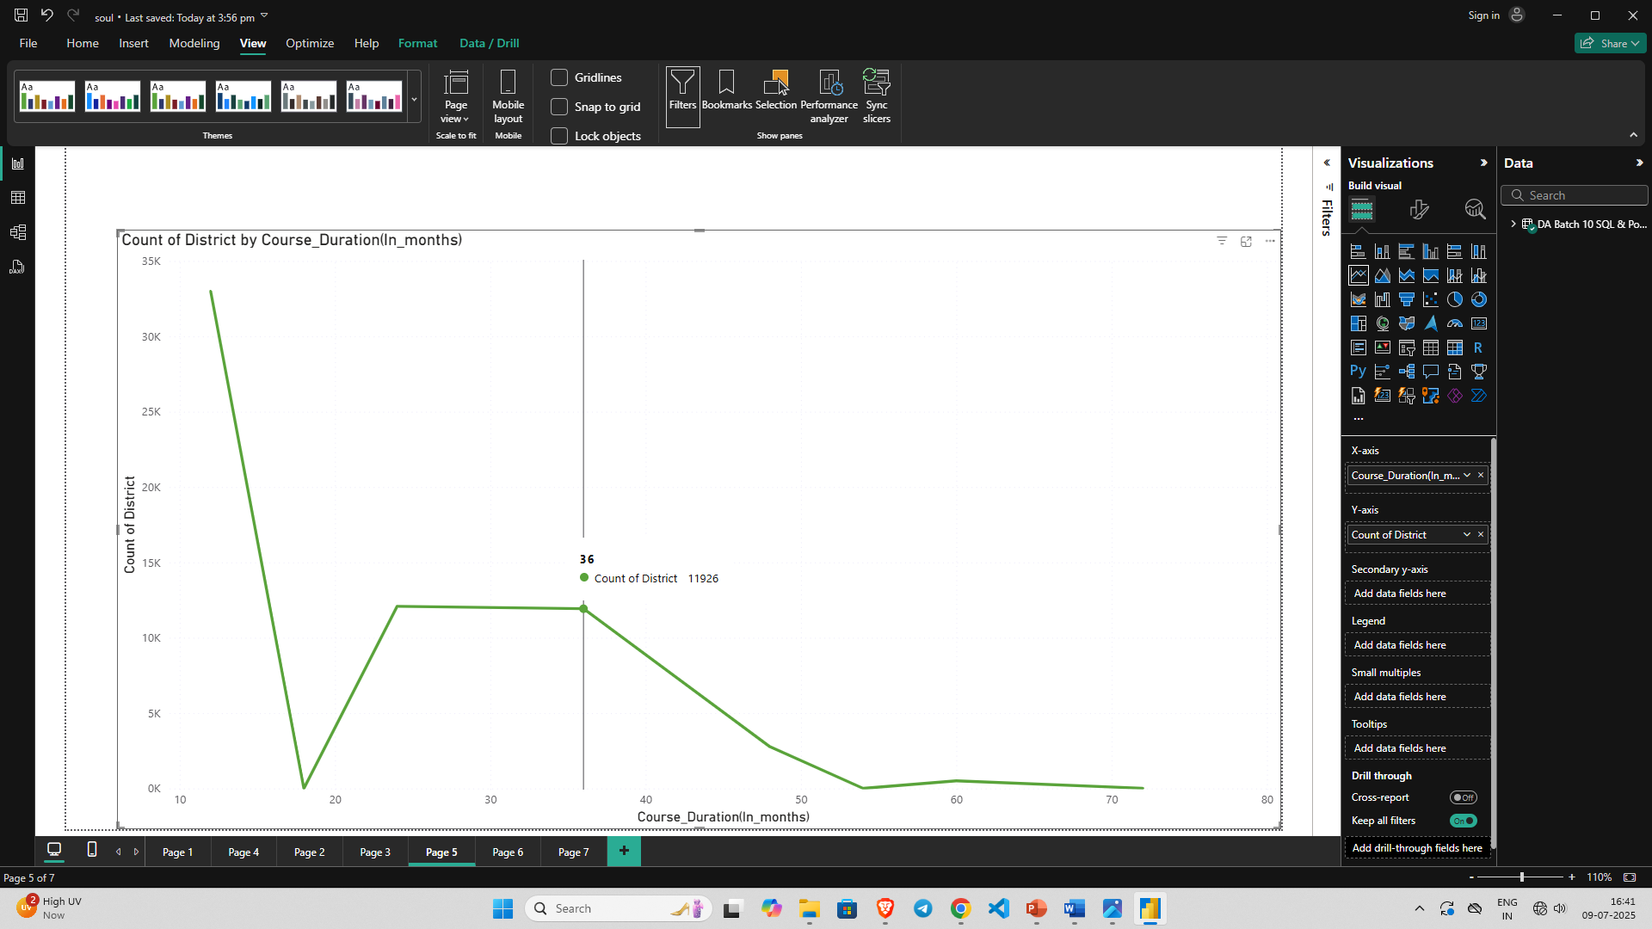
Create Visualizations - Line Chart
1

Slide 14
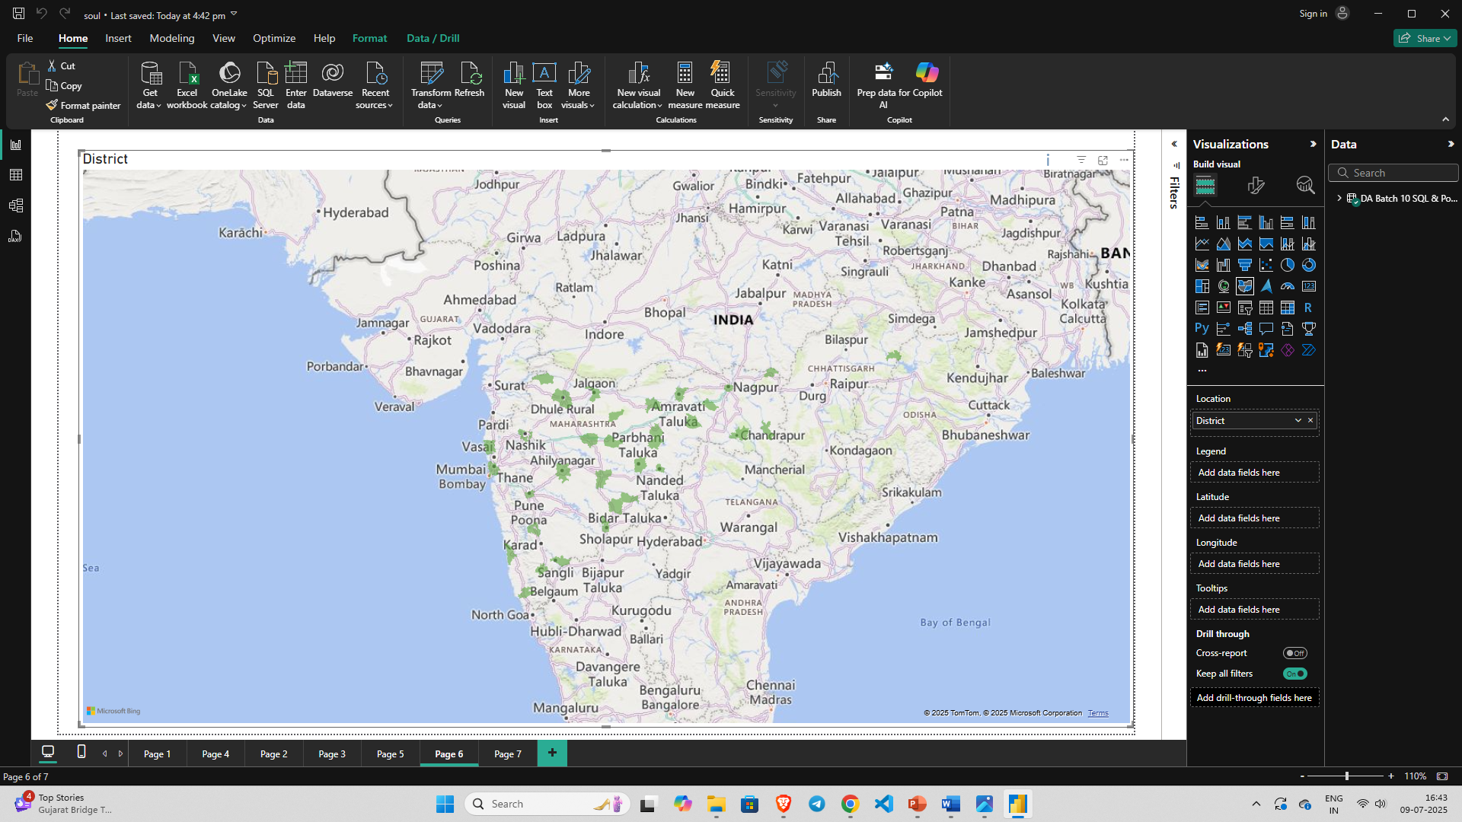
Create Visualizations - Map Visual
1

Slide 15
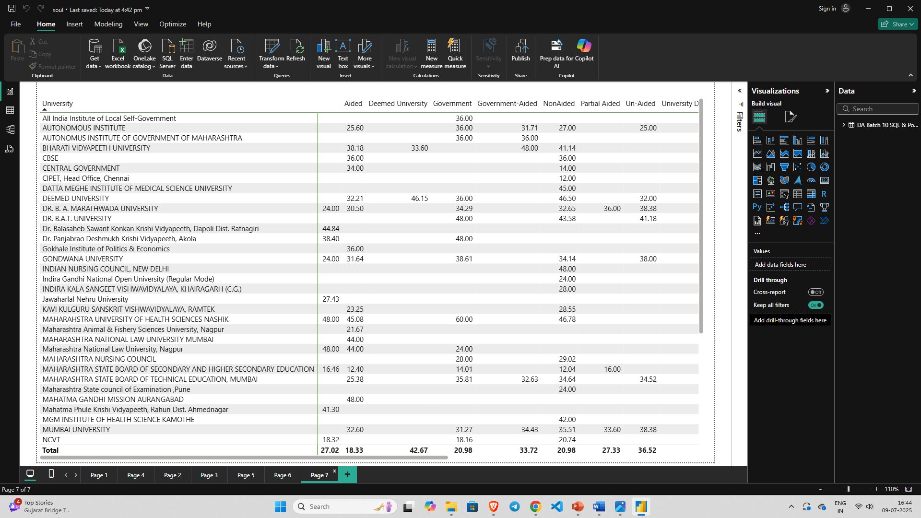
Create Visualizations - Table
1

Slide 16
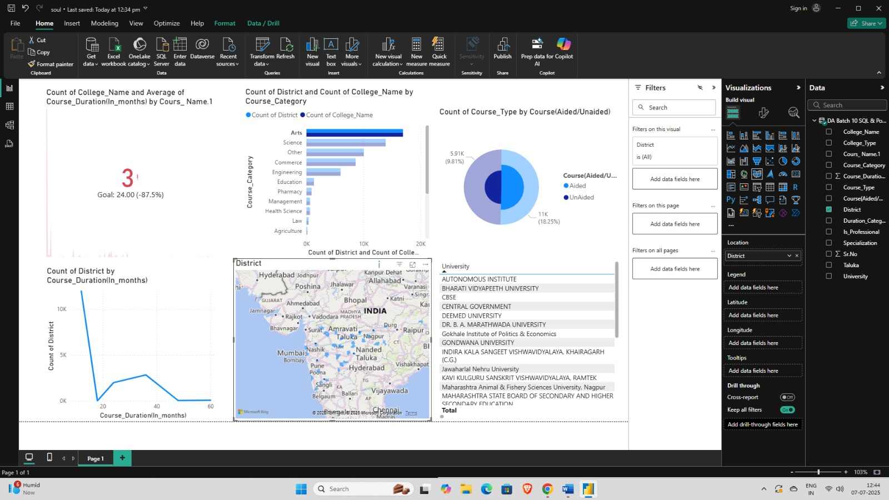
Create Visualizations
1

Slide 17
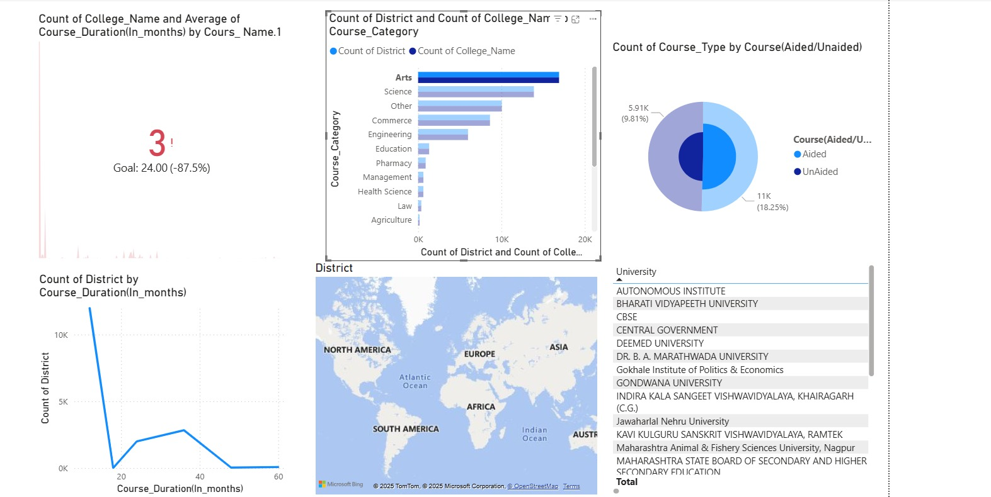
Add Interactivity
1

Slide 18
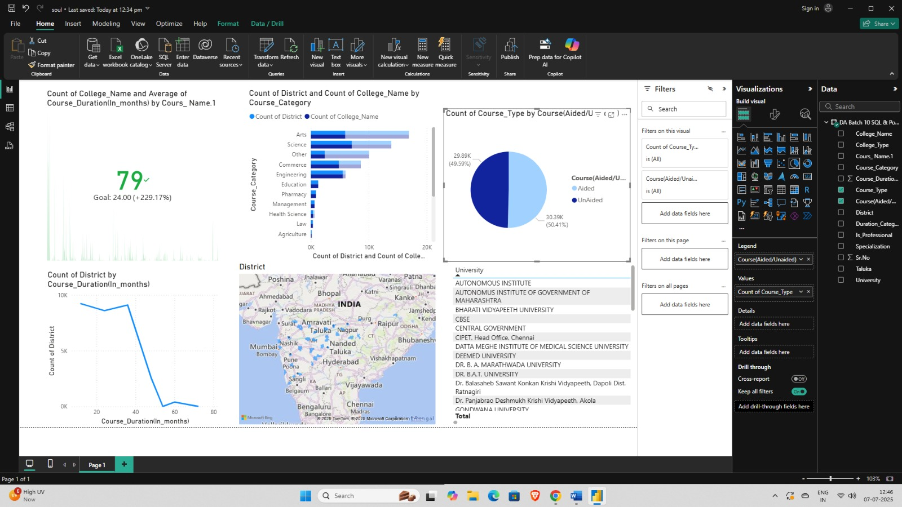
Add Interactivity
1

Slide 19
Add Interactivity
1

Slide 20
Conclusion
As I reflect on this Power BI project, I can confidently say that:
My Power BI project successfully transformed raw educational course data into meaningful and actionable insights.
I focused on cleaning, analyzing, and visualizing the dataset.
The outcome is an interactive dashboard that provides a clear overview of colleges, universities, and their diverse course offerings.
This process significantly enhanced my data proficiency.
It also demonstrated the immense potential of Power BI for data-driven decision-making in the higher education sector.

Slide 21
Thank You

